Slide 1
The Power of Data
Class Lecture / Discussion

Slide 2
What is this data stuff you talk about?
Go to pollev.com/jessiesmith057
Survey questions

Slide 3
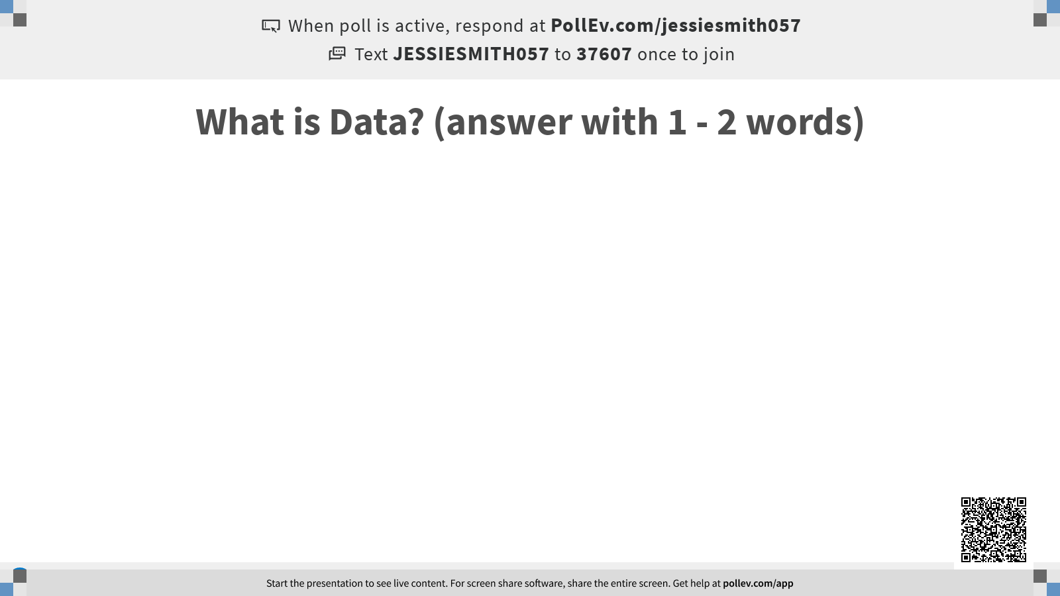
Notes:
Here’s a hint: (this is data)

Slide 4
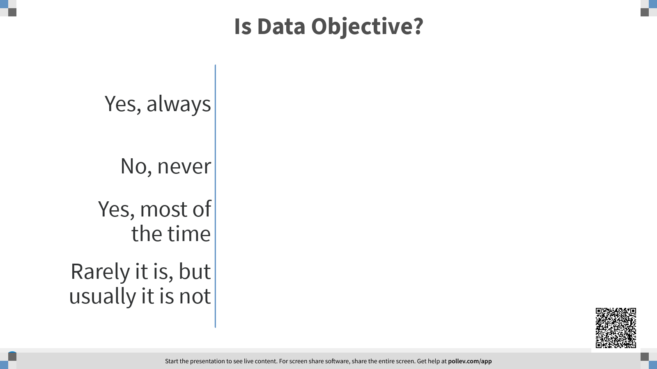

Slide 5
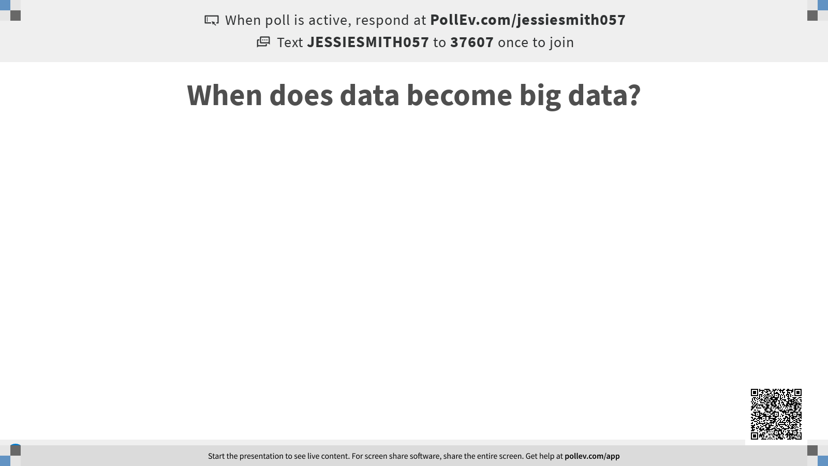

Slide 6
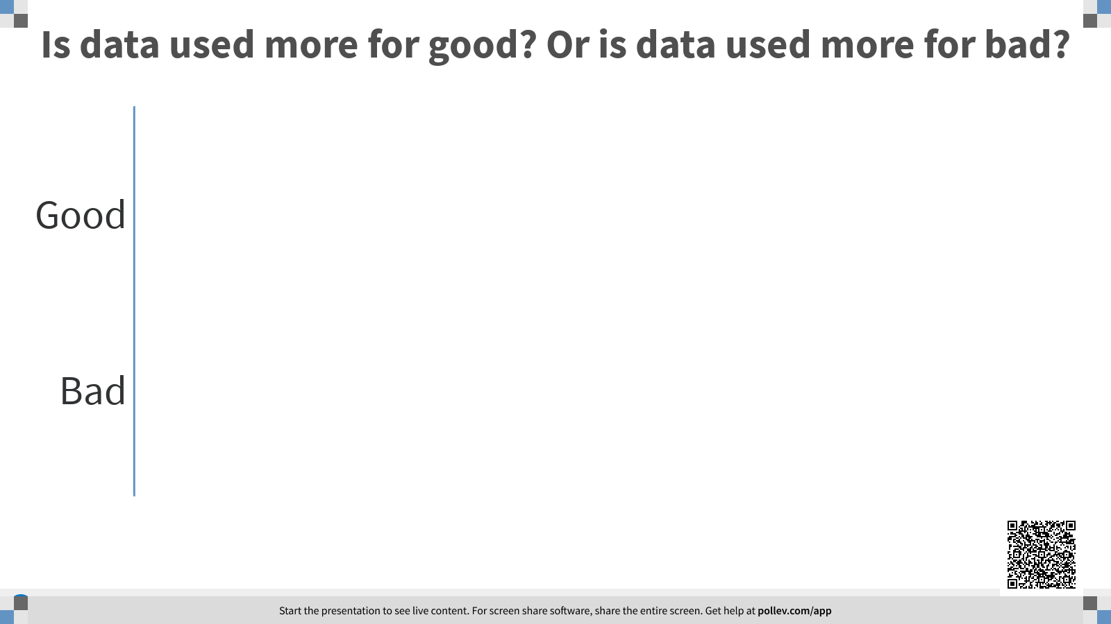

Slide 7
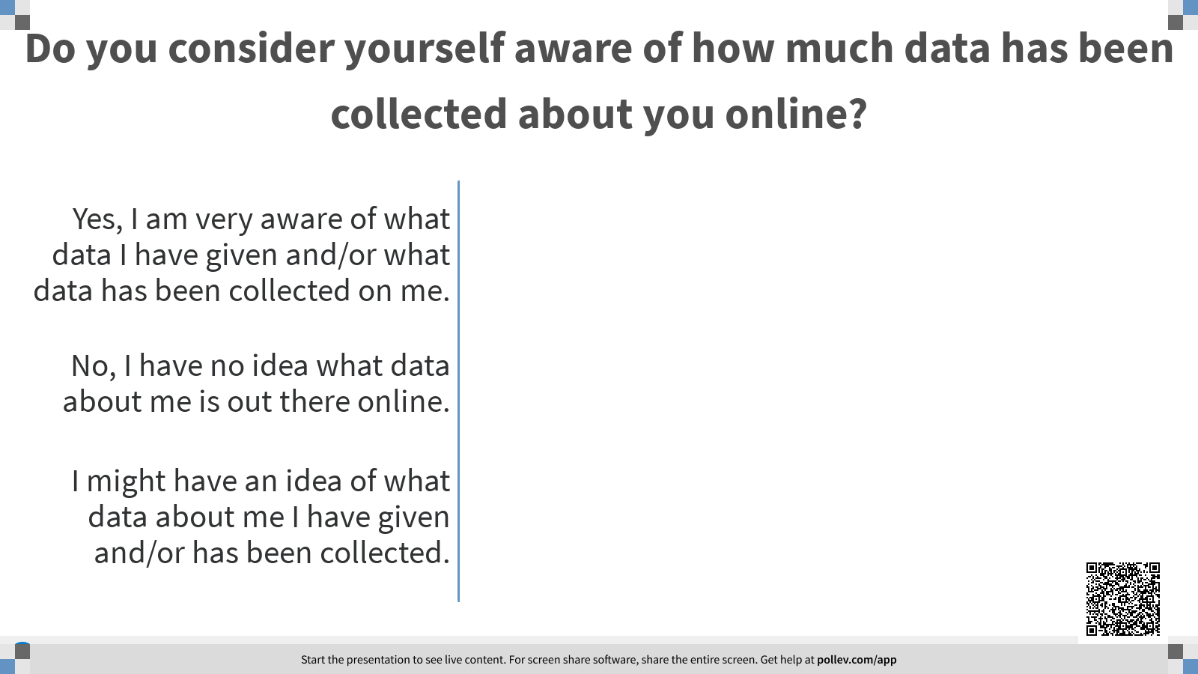

Slide 8
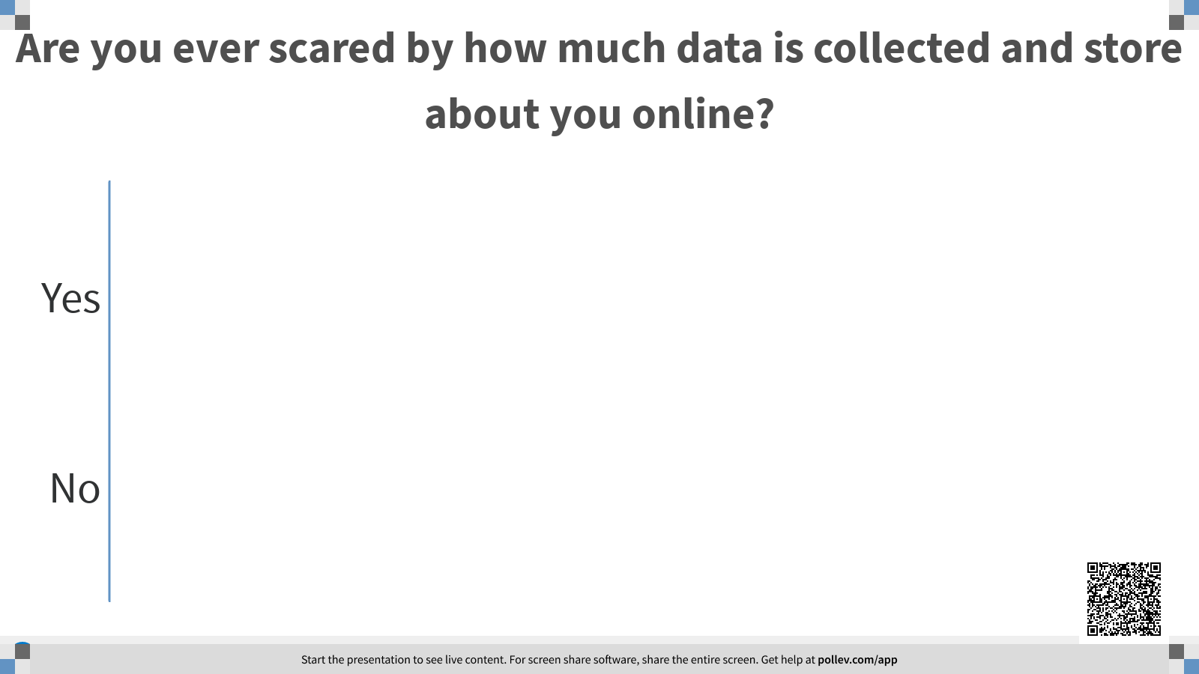

Slide 9
Digital Identity
Activity: Make a list of all of the companies / websites that you think have some sort of data stored about you. (5 mins)
How many did you write down?
How many of these are you okay having your information?
Activity: Make a list of all of the algorithms that you think use your data as fuel (5 mins)
Activity: How could your data be used for good? For bad? (write examples in the chat)

Slide 10
Machine Learning
Who knows what machine learning is?
Who knows how machine learning works at a high level?
https://www.youtube.com/watch?v=R9OHn5ZF4Uo

Slide 11
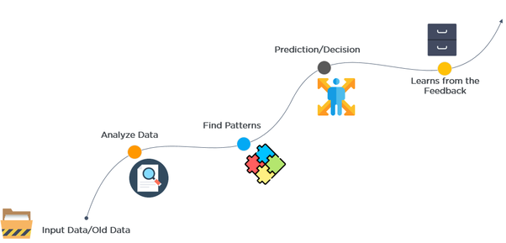
Notes:
Training data, testing data drawings

Slide 12
The Power of Data
Who has an example of when data is used to create a decision with ML (or without) that is very important?
Notes:
Predictive policing
Recidivism risk
Recommendation algorithms (and leading people to extremism / conspiracy theories)
Credit worthiness (ability to take a loan for a car or a home)
Insurance rates
News recommendation (filter bubbles / echo chambers)

Slide 13
The Power of Data
Who has an example of when data is used to create a decision with ML (or without) that is very important?
Predictive policing
Recidivism risk
Recommendation algorithms (and leading people to extremism / conspiracy theories)
Credit worthiness (ability to take a loan for a car or a home)
Insurance rates
News recommendation (filter bubbles / echo chambers)
Classification for advertisements
Facial recognition
Social credit system / ID
Phone unlocking
Job applications
Who you are friends with and in contact with (social media feeds)
Many, many, more

Slide 14
The Power of Data
Who has an example of when data is used to create a decision with ML (or without) that is very important?
When can subjective data become a bad or harmful thing?
Notes:
2. Algorithmic Bias

Slide 15
The Power of the Coder
Selects which data to use
Selects which part of that data to use
Selects the methods to teach the algorithm to use the data
Selects the metrics for success (the grade of the data)
Selects the optimal solution

Slide 16
Preparation:
Start thinking of a dataset of your own data that you would be interested in diving into!
Data you have given to companies (e.g., Facebook posts, tweets, etc)
Data you can create on your own (e.g., essays you’ve written, tracking your runs, downloading your texts, tracking your sleep, etc - start doing this now if you are interested!)
Notes:
Example: https://docs.google.com/forms/d/e/1FAIpQLSeIakEw-c2TWLlzfapK7gC1CsSRy9YKh6Dl8M7fyfJ_EqVD9w/viewform

